Slide 1

Power supply
Vlad Veliciu

Slide 2

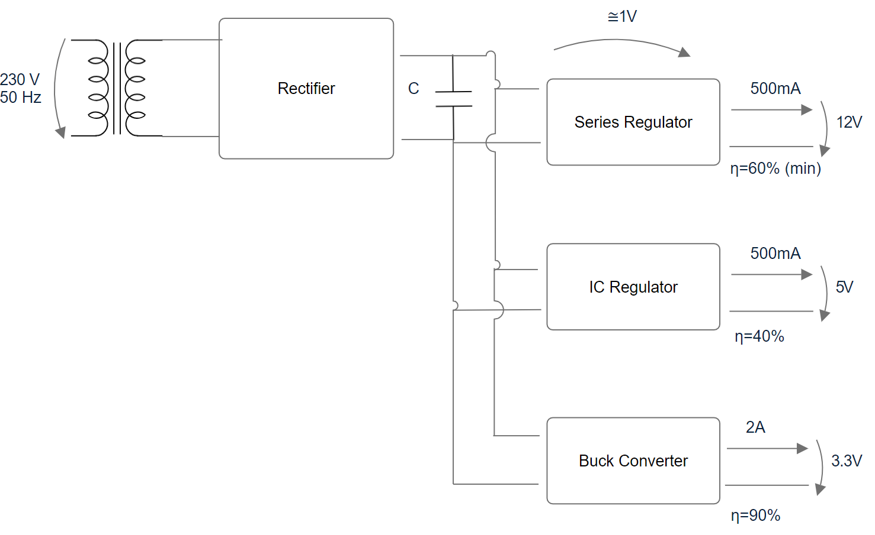
Block diagram

Slide 3
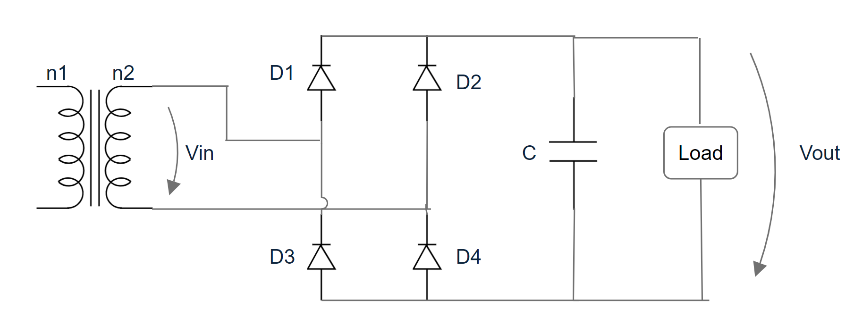
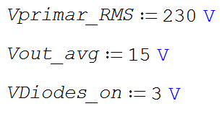
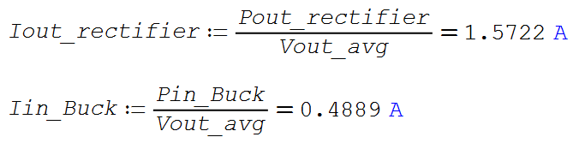
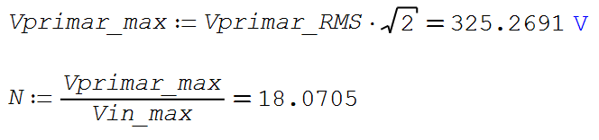
The rectifier
Functioning:
D1, D4 conduct on the positive alternance of Vin
D2, D3 on the negative alternance
C reduces the ripple

Slide 4
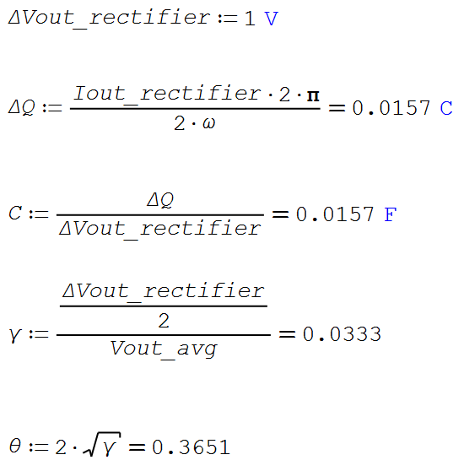
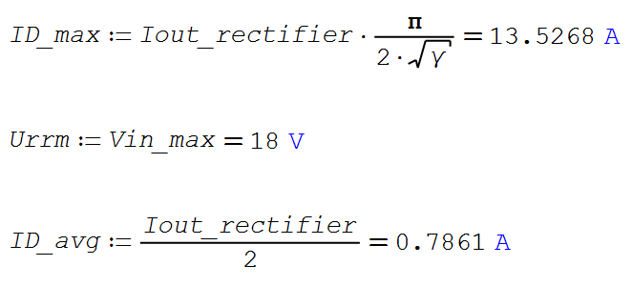
The rectifier - design
Maximum voltage ripple of 1V

Slide 5
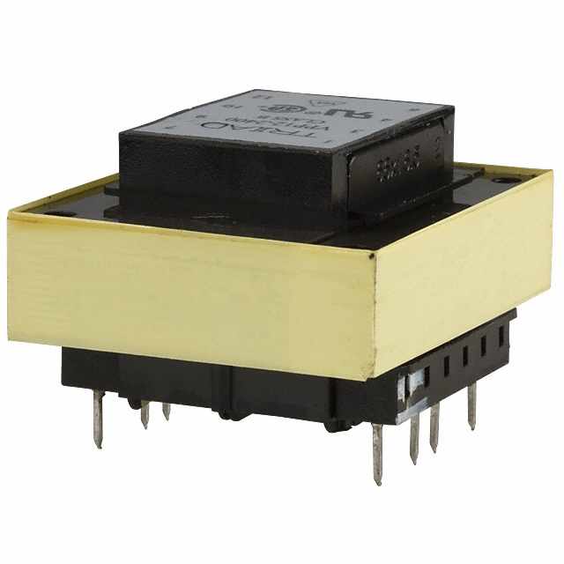
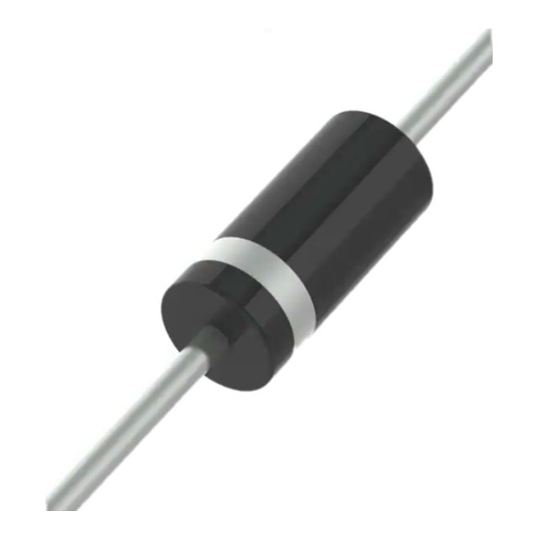
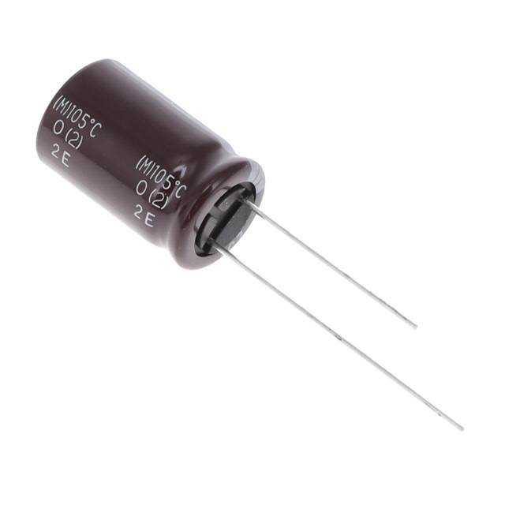
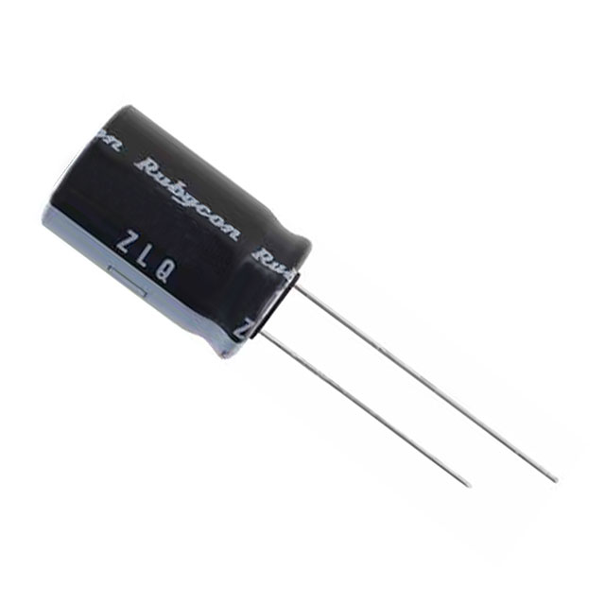
The rectifier - components
Transformer: VPP20-1500
Diodes: 1N4001
URRm = 50V
Idmax = 30A
Iavg <1A
Capacitors: 7x EKYC250ELL202MK20S (2mF) and 1x 25ZLQ1800MEFC12.5X20 (1.8mF)

Slide 6
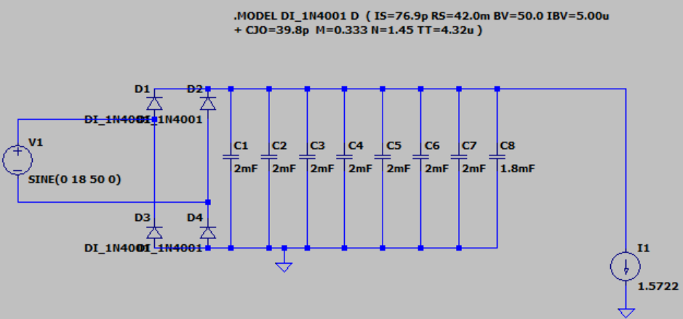
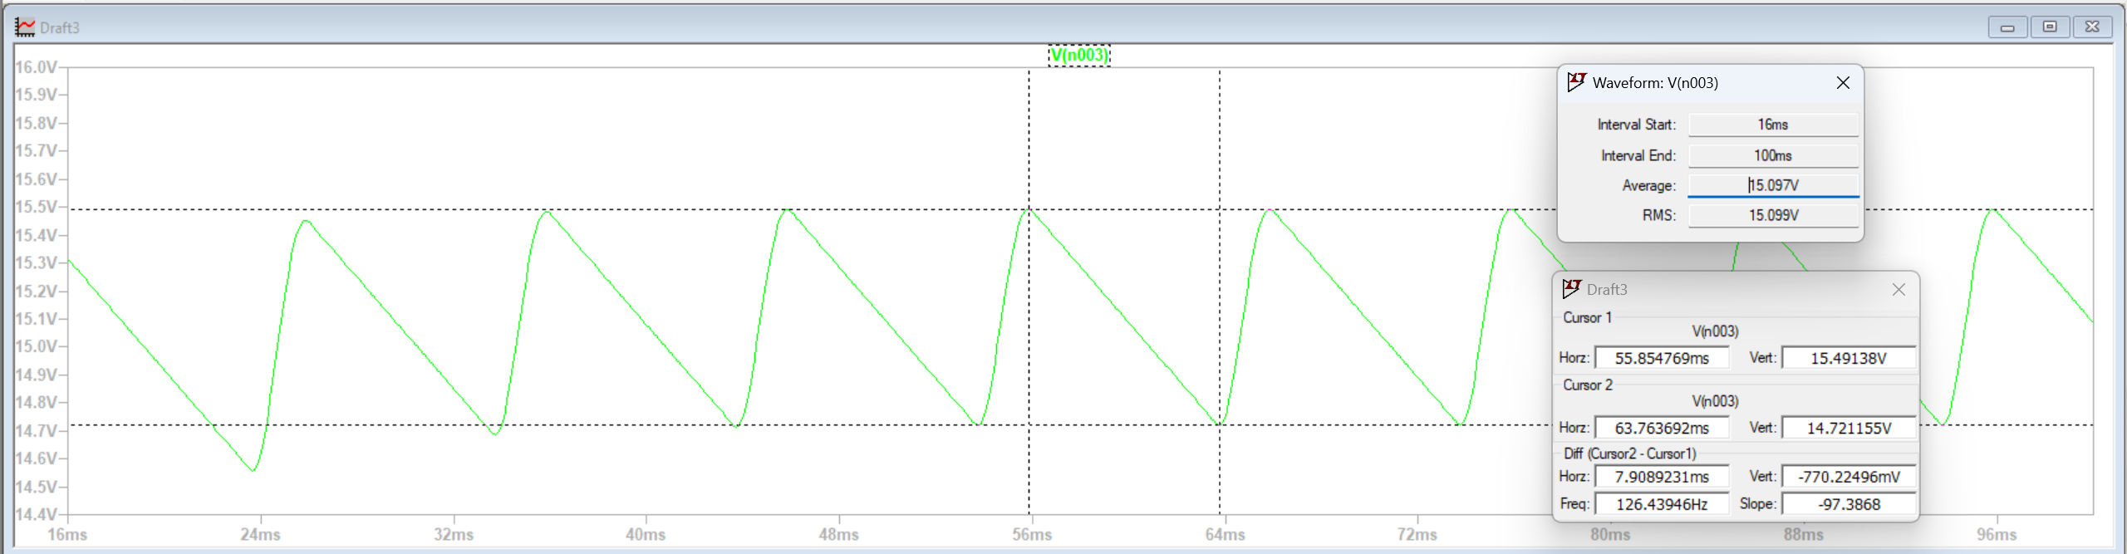
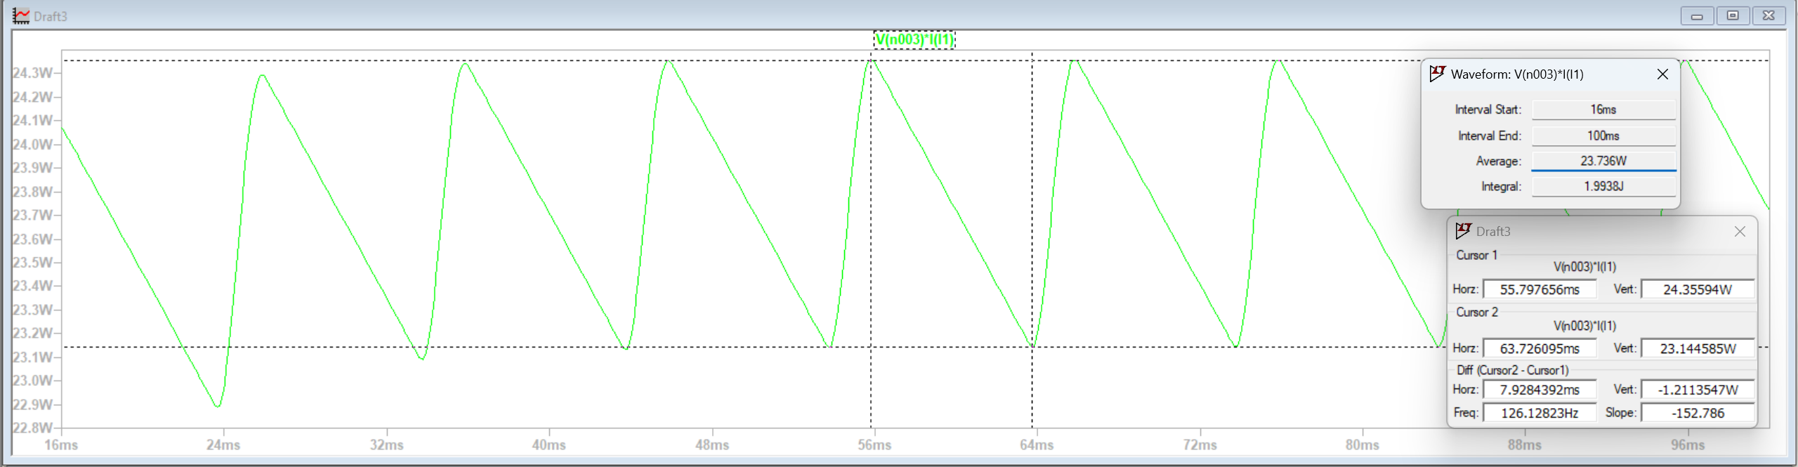
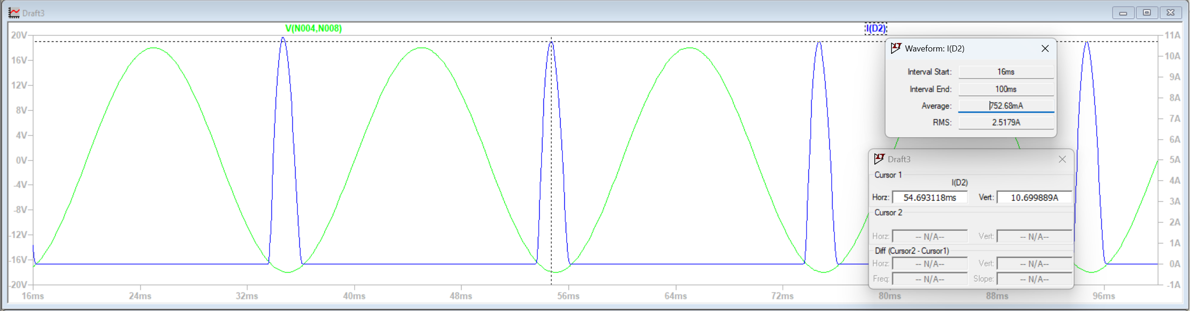
The rectifier - simulation
Voltage ripple
Output power
IDmax

Slide 7
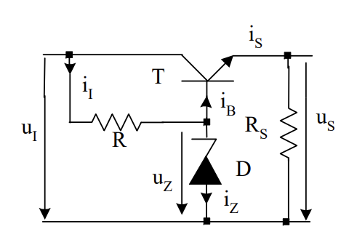
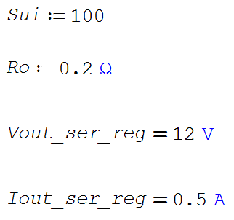
Series voltage regulator

Slide 8
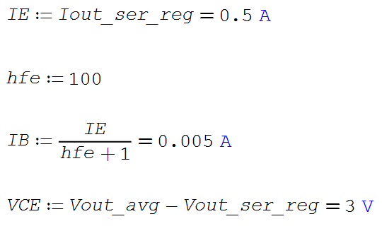
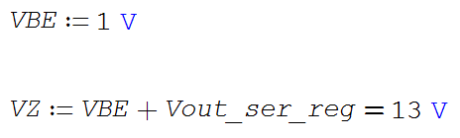
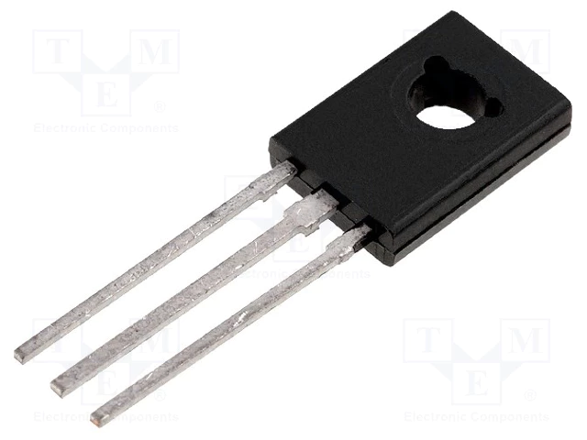
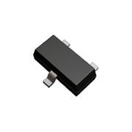
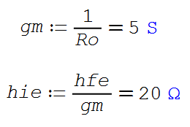
Series voltage regulator - design
For the transistor:
For the Zener diode:
Chosen components:
BD135-16
BZX84C13VLY

Slide 9
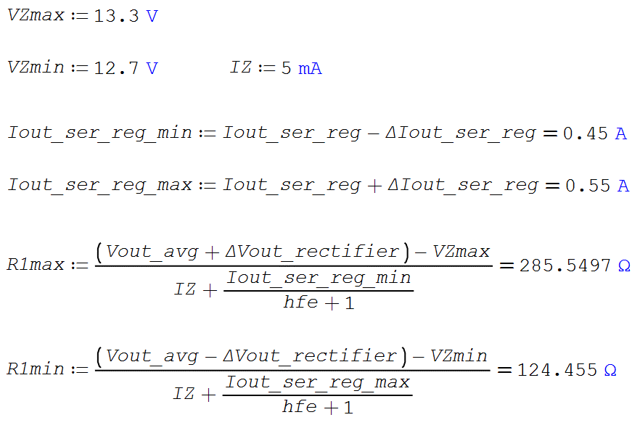
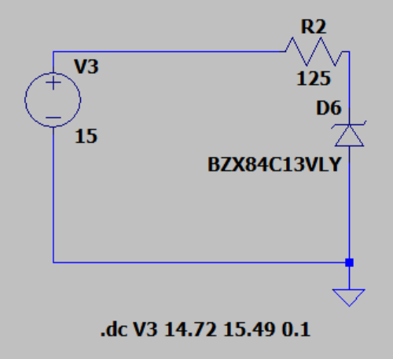
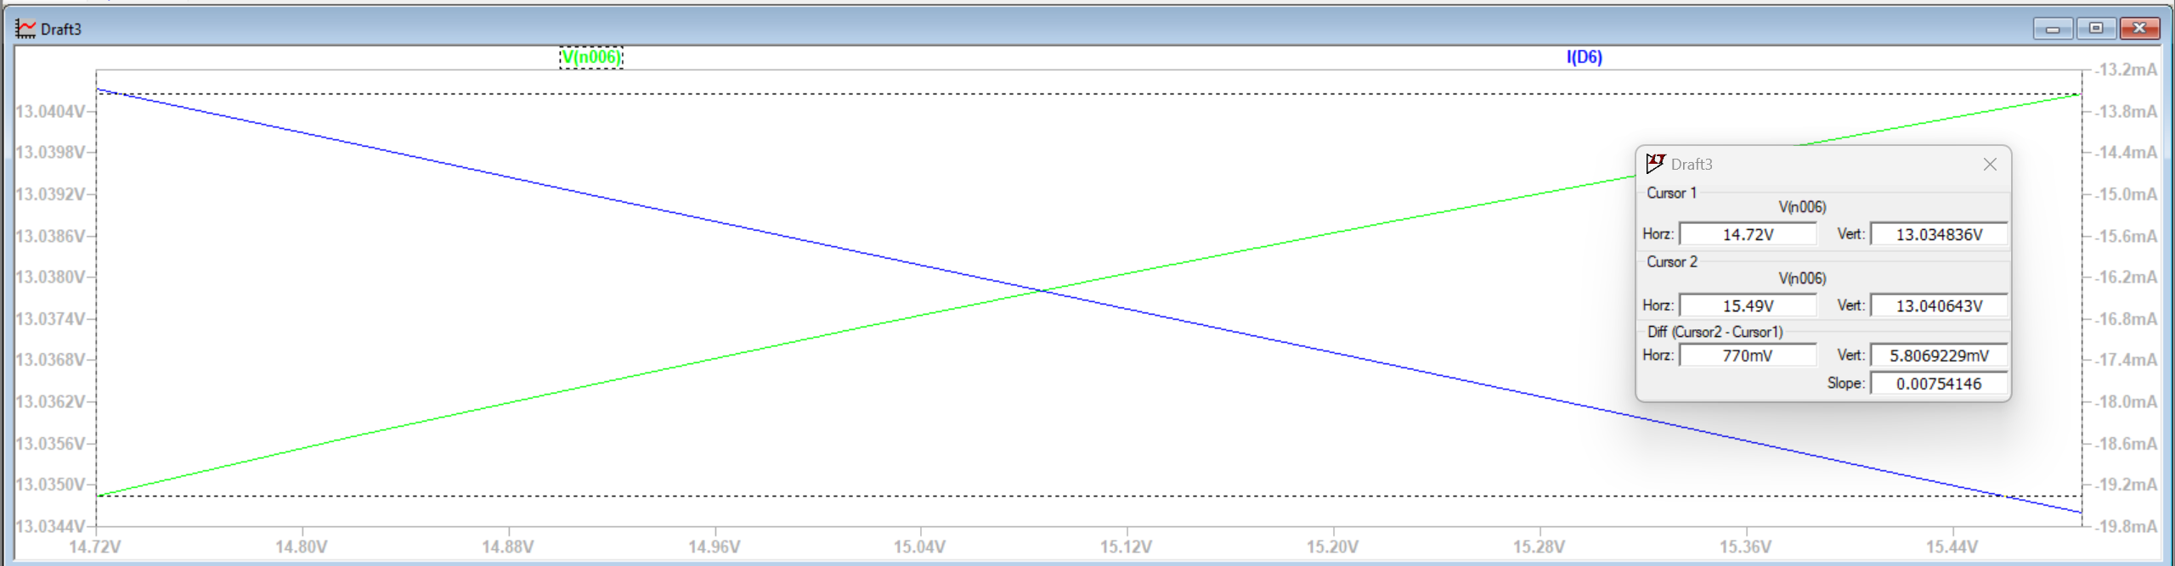
Series voltage regulator - design
Internal resistance Zener diode:
RZ=0.95Ω

Slide 10
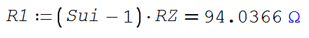
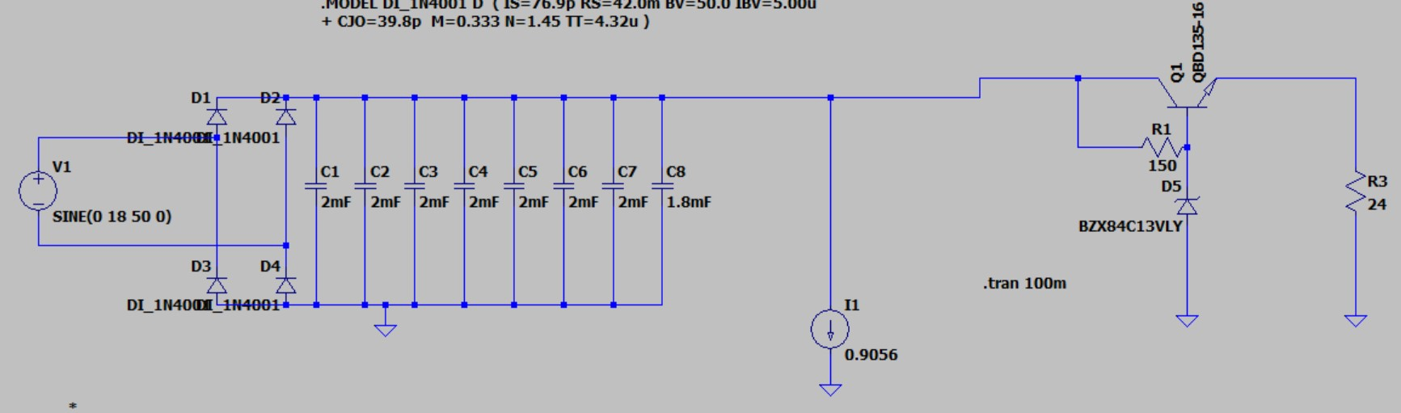
Series voltage regulator - design

Slide 11
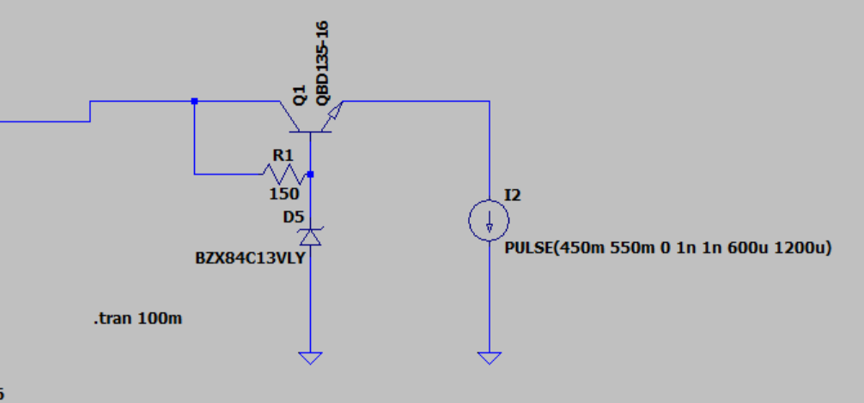
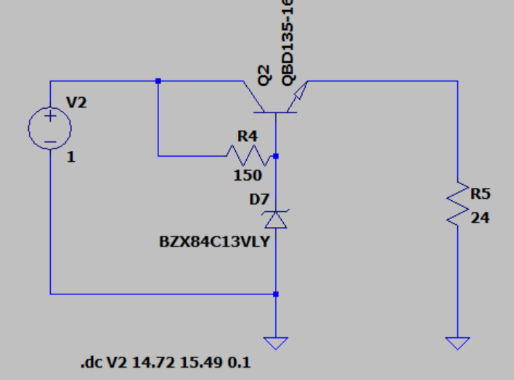
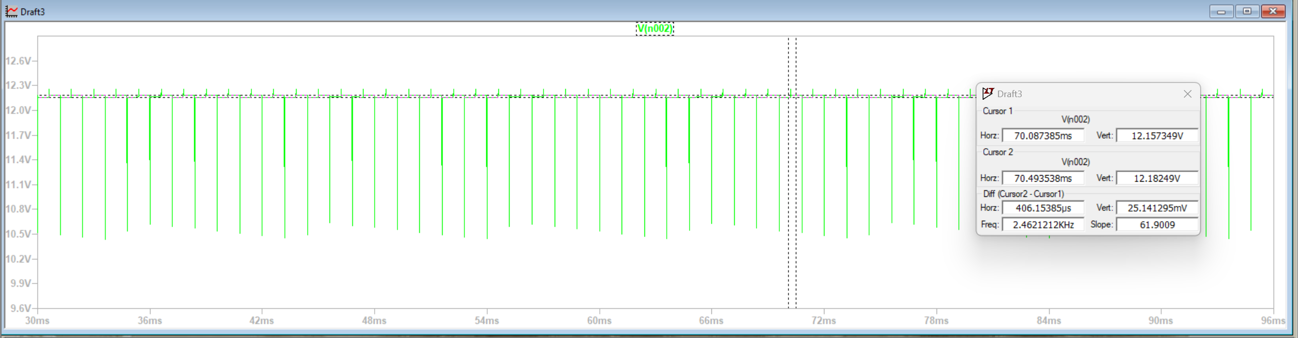
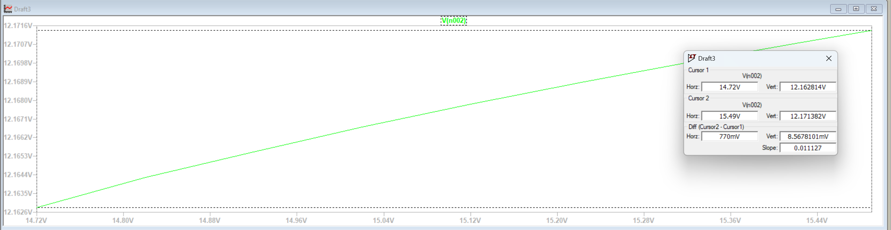
Series voltage regulator - simulations
Ro = 0.25Ω
Sui = 89.87

Slide 12
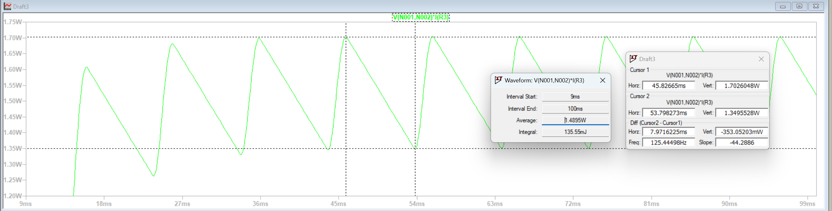
Series voltage regulator - simulations
Pdmax = 1.7W
Pdavg = 1.48W

Slide 13
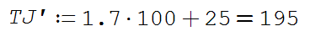
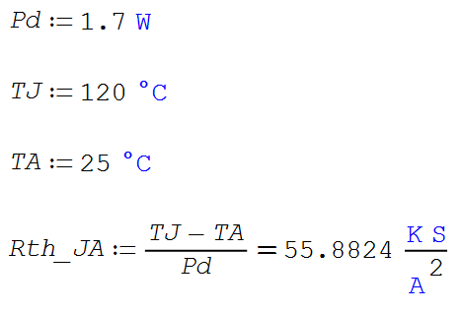
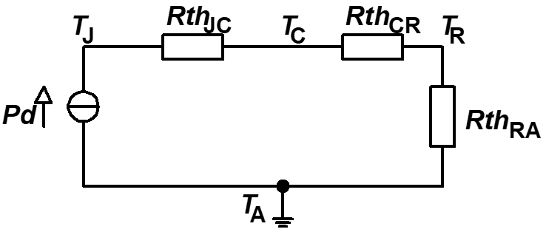
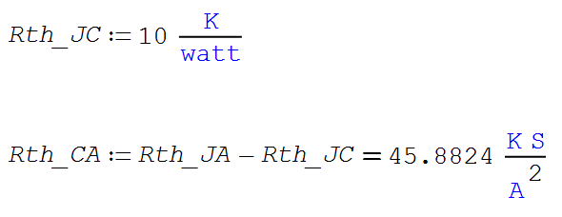
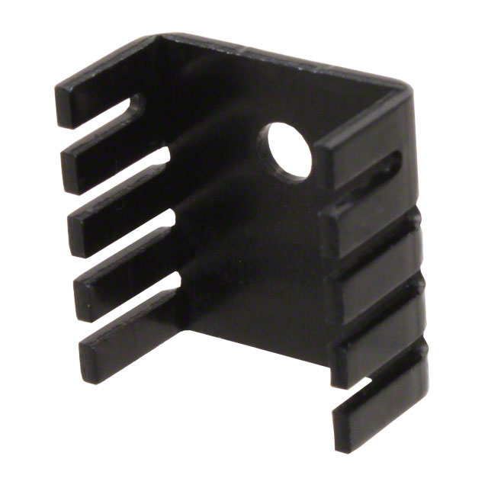
Series voltage regulator – heatsink for transistor
507302B00000G
→
Rth = 24 °C/W

Slide 14
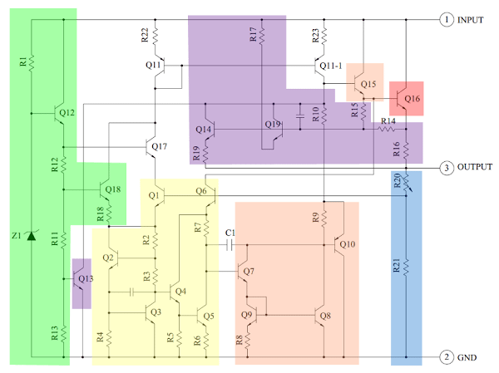
IC voltage regulator
LM7805
Yellow: Bandgap reference
Green: Start-up circuit
Purple: Protection circuits
Q16: controls current between
input and output
Orange: Amplifier
Vin = 7.5V…20V
Vout = 4.75V…5.25V
Notes:
Q16 – controls current between INPUT and OUTPUT and so the output voltage
Yellow – bandgap reference (keeps the voltage stable): error signal from bandgap fed to Q7 and the orange part (amplifier)
Amplified signal controls Q15 which itself controls Q16 -> feedback
Green part – start-up circuit (initial current for the bandgap)
Q13 – protection from overheat
Q19 – overvoltage protection from input
Q14 – overcurrent protection from output
Blue part (voltage divider), sets output voltage

Slide 15
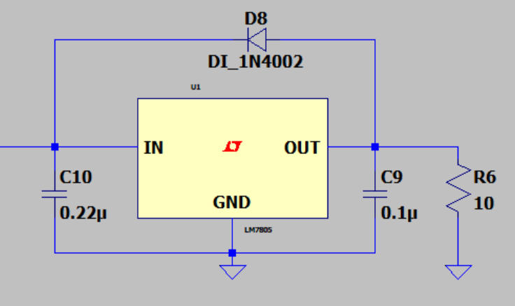
IC voltage regulator
Decoupling capacitors: filter out the noise
(high frequency and transient signals)
Diode: protects series pass transistor
Notes:
Decoupling capacitors: at frequency of the noise they have very low impedance and drive the noisy components to GND
Capacitor at input: required if IC placed far from the rectifier
Capacitor at output: helps the transient response (reduces rise/fall times and overshoot)
Diode: prevents reverse biasing of the series pass transistor if the output voltage goes higher than the input one

Slide 16
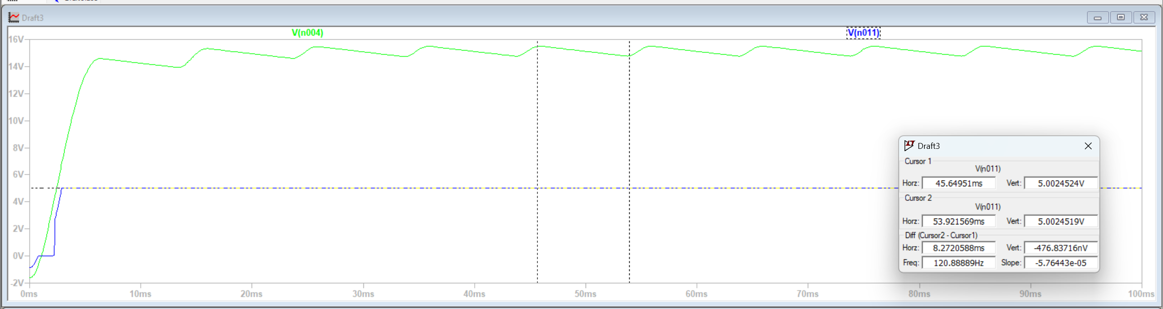
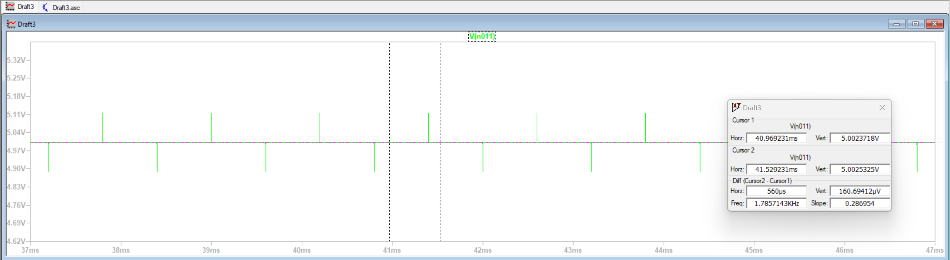
IC regulator - simulations
Sui = 2000000
Ro = 0.0008Ω

Slide 17
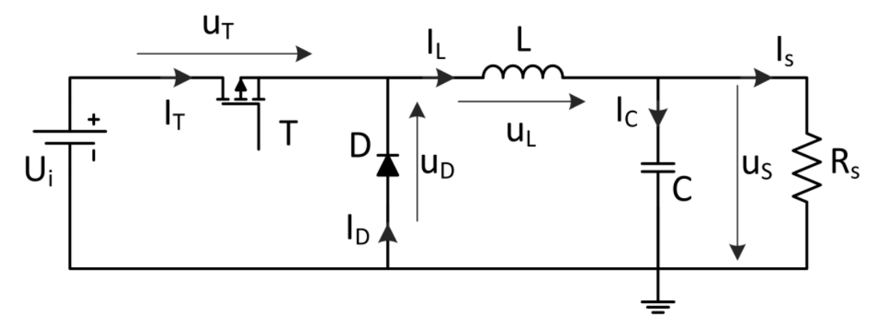
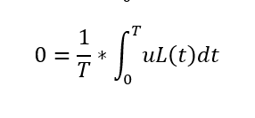
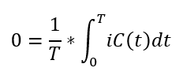
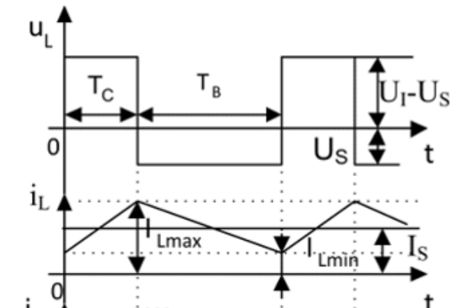
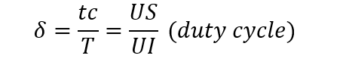
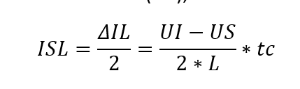
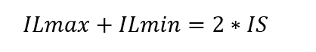
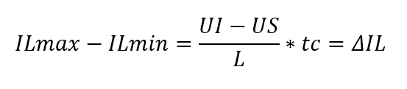
DC-DC step-down Buck converter

Slide 18
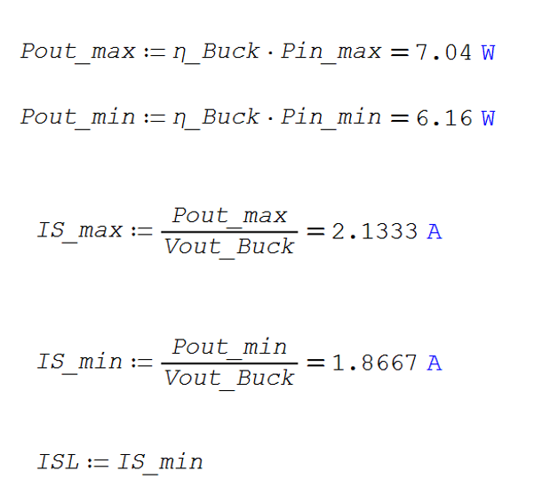


DC-DC step-down Buck converter
→

Slide 19


DC-DC step-down Buck converter – inductor design
Chosen inductor: PA2729.443NL (44μH and maximum saturation current of 7.3A )

Slide 20




DC-DC step-down Buck converter – transistor and diode design
Transistor:
Diode:
Chosen transistor: BSC093N04LS (VDSmax=40V and IDSmax=13A)
Chosen diode: B530C (Idavgmax=5A and Urmax=30V)

Slide 21




DC-DC step-down Buck converter – capacitor design
Chosen capacitor: 50ZLJ560M12.5X20 (Umax=50V and IRMSmax=1.26A)

Slide 22



DC-DC step-down Buck converter – simulations
Iout
Vout
IS

Slide 23


DC-DC step-down Buck converter – simulations
UT (blue)
IT (blue)

Slide 24


DC-DC step-down Buck converter – simulations
UD (blue)
ID (blue)

Slide 25


DC-DC step-down Buck converter – simulations
UL
IL

Slide 26

DC-DC step-down Buck converter – simulations
IC

